Slide 1
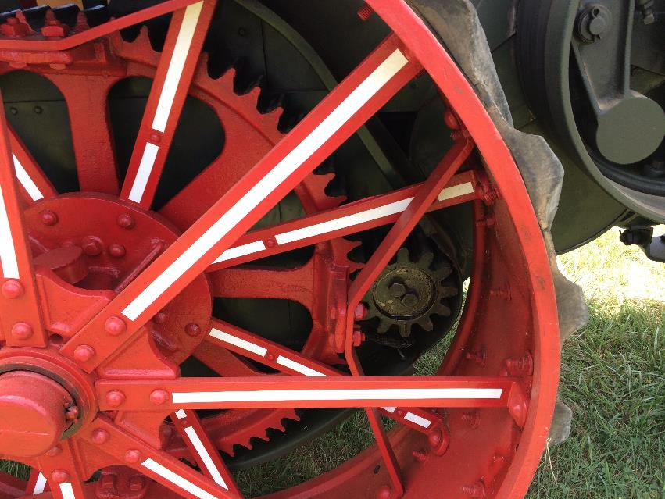
Robotics
Drive Mechanism Basics
LabRat Scientific
© 2018

Slide 2
Wheel Types
Wheel selection is an important facet of the drive system (examples are given on the next slide). Things to consider include:
The surface your robot will be running on. Carpet can make it difficult to turn, so unpowered wheels should offer low lateral resistance.
Are you going to be pushing on other robots as part of your defense strategy? If so, wheels that grip the floor are important.
Do you require high maneuverability? If so, you may want to consider Mechanum wheels which actually allow the robot to drive “sideways”.

Slide 3
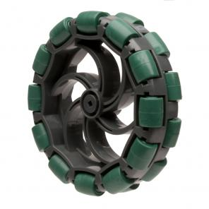
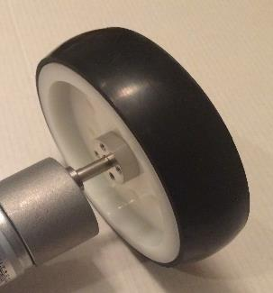
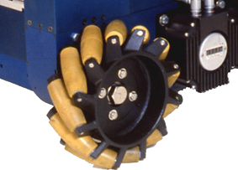
Wheel Types
Omni-directional wheels (wheels with lateral rollers to make two wheel drive systems turn easier)
High Grip Wheels
Mechanum Wheels (Wheels that enable the robot to move sideways)
Standard Wheel

Slide 4
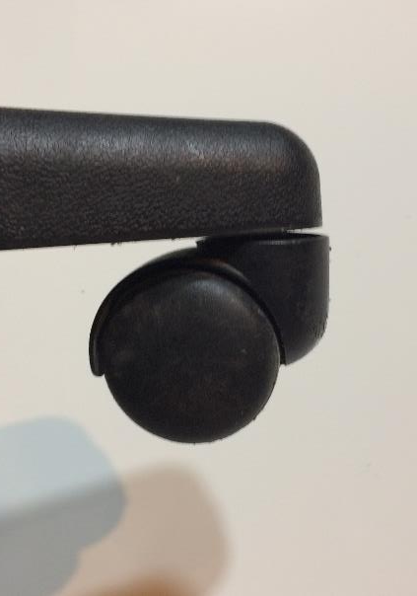
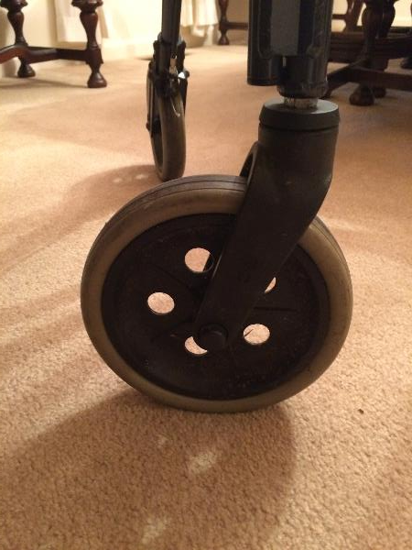
Wheel Types
Pivoting casters can be used on the front of the robot when a two-wheel drive system in employed. The casters pivot as necessary to allow the wheels to roll freely in the direction of motion.
One issue is that it is easy for competitor to bump the robot and make it point in an undesirable direction. Omni-directional wheels tend to have this same issue.
Casters

Slide 5
There are several different ways to connect the wheels to the drive motor. They all have their one pro’s and con’s.
In general, the robots won’s have steering mechanisms like a car, instead they operate one wheel (or set of wheels) on one side to the robot to turn in one direction, and then operate the wheel(s) on the other side to turn the other direction. The robot goes forward or reverse by operating both side at the same time.
Let’s look at the more common methods for connecting motors to wheels…

Slide 6
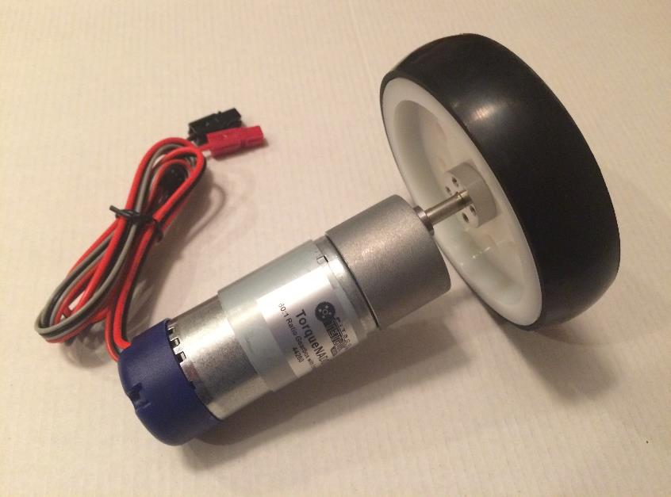
Direct Drive
Wheel is connected directly to the motor
Torque can not be altered
Speed can not be altered (unless motor speed can be adjusted electrically)
Can put motor shaft under stresses that could damage the motor (e.g. another robot runs into the wheel)
Motor must be placed right next to the wheel

Slide 7
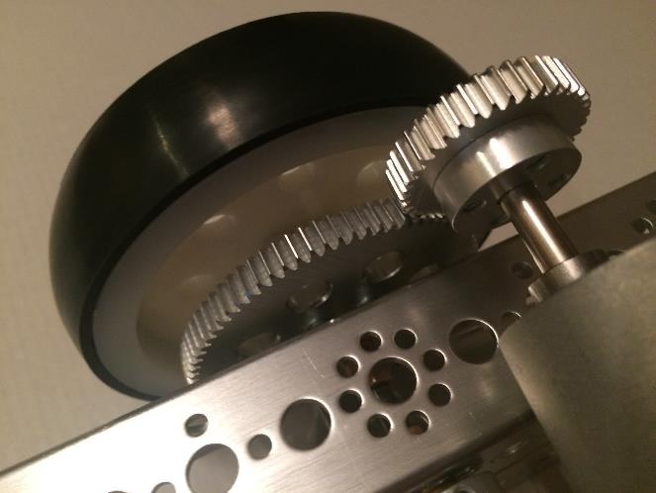

Gear Drive
Gear drive on old steam tractor
Different size gears can be used to alter speed and torque
Positioning must be more precise to ensure gear teeth engage properly
Motor must be placed in close proximity to the wheel

Slide 8
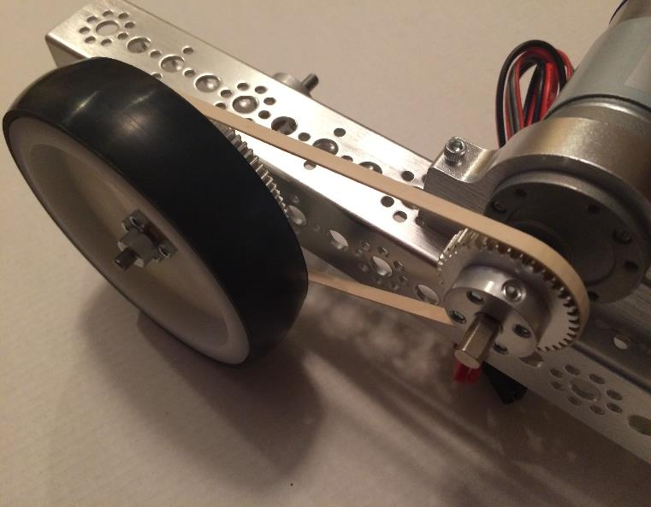
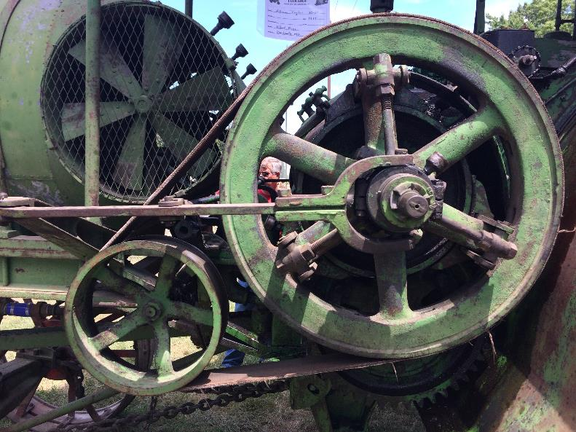
Belt Drive
Simulated belt drive – motor rotation is transferred to the drive wheel via a flexible belt.
Belt drive system on old tractor. Flat leather belt is being used.

Slide 9
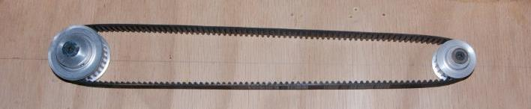
Belts and Pulleys
Types
  Toothed (as shown above)
  V-belts (similar to those used in a car engine)
  Flat (similar to tractor image on previous slide)
Considerations
  Quite Strong (but they can break under extreme loads of after extensive wear)
  Toothed belts don’t slip, but flat belts can…
  Allows motors to be placed farther away from wheels if necessary
  Different pulleys sprockets can be used to alter torque and speed
  Fixed lengths – Buy proper length, or position components accordingly
  Can stretch over time and become loose

Slide 10
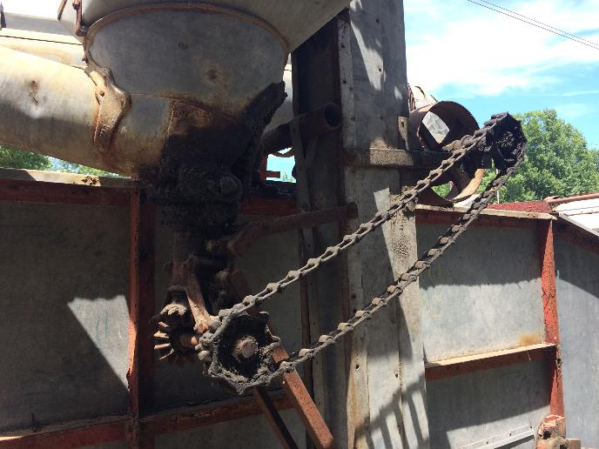
Chain Drive
Simple chain drive on FRC Robot. Notice the different size sprockets on the motor and wheel.
Chain drive on old grain thrasher

Slide 11
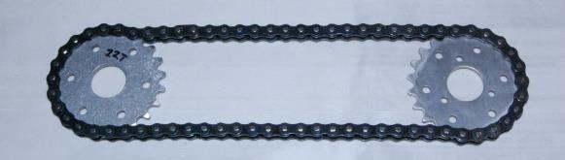
Chain and Sprockets
Types
  Heavy metallic chains are generally used for heavy load applications
  Plastic chains can be used if torques and loads are lower
Considerations
  Strong
  Don’t slip
  Allows motors to be placed farther away from wheels is necessary
  Different sized sprockets can be used to alter torque and speed
  Can be adjusted by removing links
  Generally don’t stretch over time

Slide 12
Torque
“Torque” has been referenced in previous slides. Torque is the amount of “twisting” force being supplied by some type of rotating device. Why is torque important ?
Needed to be able to push other robots (defense)
Needed to climb inclines or obstacles
Let’s look and the climbing problem to see how to determine the required torque…

Slide 13
Why is Torque Important ?
The torque being applied to the wheel by the motor…
… results in the wheel applying a force against the surface it is travelling over.
Torque being applied by the motor
As the incline increases, the torque requirement generally increases
(but keep in mind that friction will decrease as the incline increases due to less force acting towards the surface – slippage could occur…)
Force being applied by the wheel
Incline Angle

Slide 14
Why is Torque Important ?
The robot’s weight acts towards the center of the earth – which in this example is straight down.
Weight Force acting parallel to Incline
Engineers tend analyze things parallel and perpendicular to a reference surface – in this case the surface of floor which is inclined.
Weight Force acting Perpendicular to Incline
Weight of Robot
Trigonometry is used to calculate the force components.
Incline Angle

Slide 15
Why is Torque Important ?
In this analysis it is necessary to look at the forces that are parallel and perpendicular to the surface the robot is travelling on. However, in this case we don’t really need to worry about the perpendicular force…
Force_{Par} = Wt * Sine (Ang)
Recall from geometry how the 30 deg incline angle transfers to the diagram at the right… As a sanity check, how does the angle between the purple and back lines change as the incline angle goes to zero? The purple force becomes the weight force and the angle is Zero…
Force_{Perp} = Wt * Cos (Ang)
30⁰
30⁰
20 N
20 N
30⁰

Slide 16
Why is Torque Important ?
The RED equation can be used to calculate the force that the drive system must fight against:
Force_{Par} = Wt * Sine (Ang)
Force_{Parallel} = 20 N x Sine (30)
= 20 N x 0.5
= 10 N
Force_{Perp} = Wt * Cos (Ang)
30⁰
NOTE: Calculating the perpendicular (a.k.a. normal) force shows how the frictional force
(F = Normal Force x Coefficient of Friction) decreases as the incline increases…
20 N

Slide 17
Weight Force
Wheel Force = Weight Force
Note: The wheel pushes on the surface, and the surface pushes with an equal and opposite force(Newton’s Law – hence the use of the dual arrows…
To keep from rolling back, the wheel force must be equal to the weight force. To climb, the wheel force must be greater than the weight force (Newton’s Law).

Slide 18
Weight Force
Wheel Force = Weight Force
The motor applies a torque (force over a distance) to the wheel. This either simply spins the wheel when the wheel is not in contact with a surface, or it applies a force to the surface (if the system is not “stalled” the wheel will also rotate)…

Slide 19
Let’s assume the radius of the wheel is 0.1 M
The gravity force acting parallel to the surface in 10 N.
0.1 m
10 N
Wheel Force = Weight Force
This is actually just the “stall torque” which means it exactly balances the required torque. If the robot is to climb the incline it will need to have a wheel torque greater than 1.0 N*m
Required Torque = Force x Radius
= 10 N x 0.1 m
= 1.0 N*m

Slide 20
What is the Impact of Heavy Loads Acting on a Robot?
Heavy loads (i.e. hill climbing) puts a torque strain on the drive motors
When a motor is operating under a heavy load it slows down and draws more electrical current
Higher current draw will deplete the batteries faster
  Battery capacity (duration) is measure in “Amp Hours”. This means the battery will supply power for a certain amount of time relative to the current draw.
Motors and batteries will heat up when the load is heavier
  Ever notice how warm you cell phone gets when you are “roaming” and the phone is searching for cell towers GPS…

Slide 21

QUESTIONS?

